Slide 1
“Quality Minus Junk”
An Empirical Approach to Quality Stock Picking
Presented by: Ashutosh Ekade, Gaurav Sharma, Lixiong He, Yakun Niu

Slide 2
Introduction
Background
Quality investing is a strategy that focuses on selecting stocks with superior quality characteristics, such as profitability, growth, safety.
Objective
This project aims to develop a slight variant of the findings of the "Quality Minus Junk" (QMJ) paper by Clifford S. Asness, Andrea Frazzini, and Lasse H. Pedersen, which defines high-quality stocks and investigates their risk-adjusted returns.
Key Findings
The QMJ factor, which involves going long on high-quality stocks and short on low-quality stocks, yields superior risk-adjusted returns for U.S. stocks over a long period of time vs traditional fama-french 4 factor portfolios.
The QMJ strategy returns reflect the robustness of strategy and superior returns due to mispricing as analyst expects generally lower return for high quality stocks vs junk stocks, QMJ has negative beta against market which confirms flight to quality during stress periods.

Slide 3
Methodology
Factor Design
Construct the QMJ factor by assessing stocks based on profitability, growth, safety metrics.
Calculate rank Z-scores for each factor and averaging these to get final quality score.
Track the returns of the long-short portfolio over the specified period (Jan 1973 to current)
Stock Universe
We consider the returns of all US stocks from 1973 to 2024
Portfolio Construction
Portfolios are formed by ranking stocks based on quality scores and then going long on high-quality stocks and short on low-quality stocks
We track and analyze the returns of these portfolios and compare them against fama-french factors.

Slide 4
Quality Factors
Profitability: Measures a company's ability to generate profits from its operations
Growth: Assesses a company's potential for future expansion and past earnings growth
Safety: Evaluates the financial stability and risk associated with a company
Profitability
Gross Profitability Over Assets
Gross Margins over Assets
Cash Flow over Assets
Return on Equity
Return on Assets
Growth
5-year growth of the Profitability factors
Safety
Debt-to-Equity Ratio Earnings Volatility
Altman Z-score

Slide 5
Z-Score Calculation
We rank each stocks cross-sectionally on annual rebalancing date (June 30th) on various metrics of profitability, growth, and safety factors and calculate the rank z-scores of each stock for different quality metrics.
rx = rank(x); zx = (rx - mean(rx)) / std(rx)
Average rank Z-Scores for each of the factors. Within each factor, calculate factor rank z-scores by averaging metrics rank z-scores
Combining Z-Scores
The combined quality score (Q) is an aggregate measure that averages standardized rank z-scores for Profitability, Growth, and Safety factors.
Ranking and Portfolio Construction
Stocks are placed in decile portfolios based on their combined quality rank z-scores.
QMJ long-short portfolio is constructed as QMJ01-QMJ10 (value weighted monthly returns of stocks in 1st decile - value weighted monthly return of stocks in 10th decile).
Quality decile portfolios are rebalanced every year in June based on accounting numbers of last fiscal year.

Slide 6
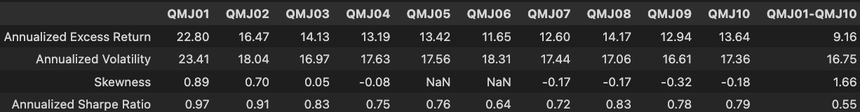
Quality Decile portfolios performance

Slide 7
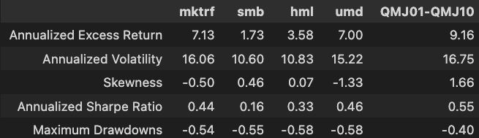
QMJ strategy vs Fama-French Factors

Slide 8
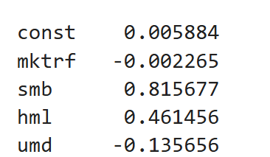
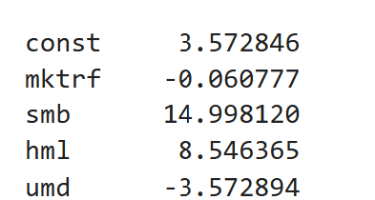
Alpha vs fama-french four factor portfolio
To analyze the alpha and information ratio of QMJ strategy, we use a multi-factor regression model.
Model Equation: QMJ = α + β1⋅MKT + β2⋅SMB + β3⋅HML + β4⋅UMD + ϵi
QMJ: Quality Minus Junk factor (QMJ long-short portfolio returns, QMJ01-QMJ10)
alpha: Intercept of Regression
MKT: Market factor (market excess return)
SMB: Size factor (Small Minus Big)
HML: Value factor (High Minus Low)
UMD: Momentum Factor (Up minus Down)
Betas
T-stats of Betas

Slide 9
QMJ Performance vs 4 FF factors from Jan-1973
Annualized Alpha
7% with a t-stat of 3.5 implying statistical significance and robustness of QMJ
The QMJ01 decile (top quality stocks) had the highest annualized excess return at 22.80%, while the QMJ10 decile (low-quality stocks) had annual return of 13.64%
The compensation over fama-french four factor portfolio as a source of risk premium
Information ratio: Annualized IR of 0.52 indicating QMJ strategy’s superior performance
Annualized returns: QMJ has highest annualized return (9.16%) vs other four FF factors.
Skewness: QMJ strategy had most positive skewness (+1.66) vs other strategies.
Sharpe Ratio: QMJ has highest Sharpe ratio of 0.55 among all strategies, followed by UMD (0.46)
Max drawdown: QMJ strategy has lowest max drawdown (40%) vs other factor strategies indicating superior capital preservation of QMJ vs fama french factors.
Beta: QMJ strategy has slight negative beta (-0.002) against market which indicates strategy should work well during market stress, which indeed is the case as seen by covid performance.

Slide 10
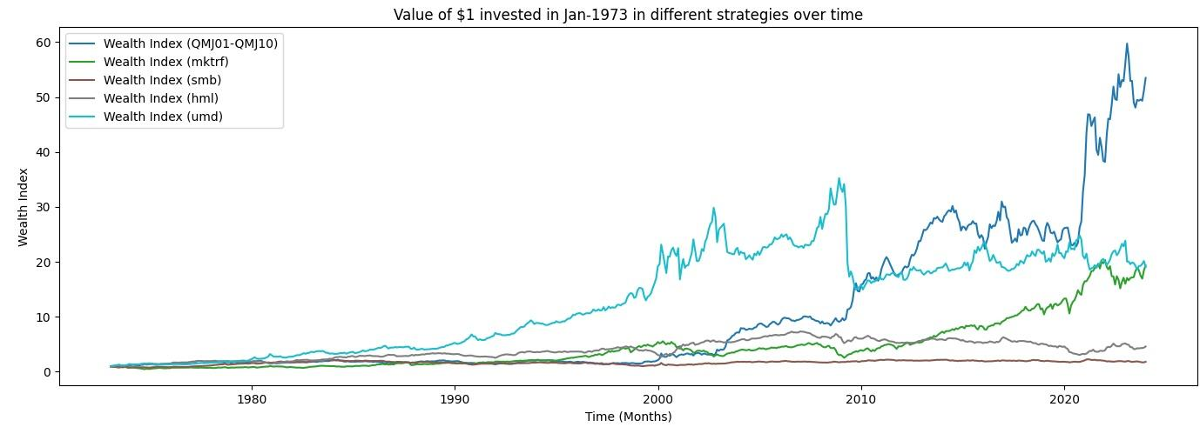
Cumulative returns of different strategies

Slide 11
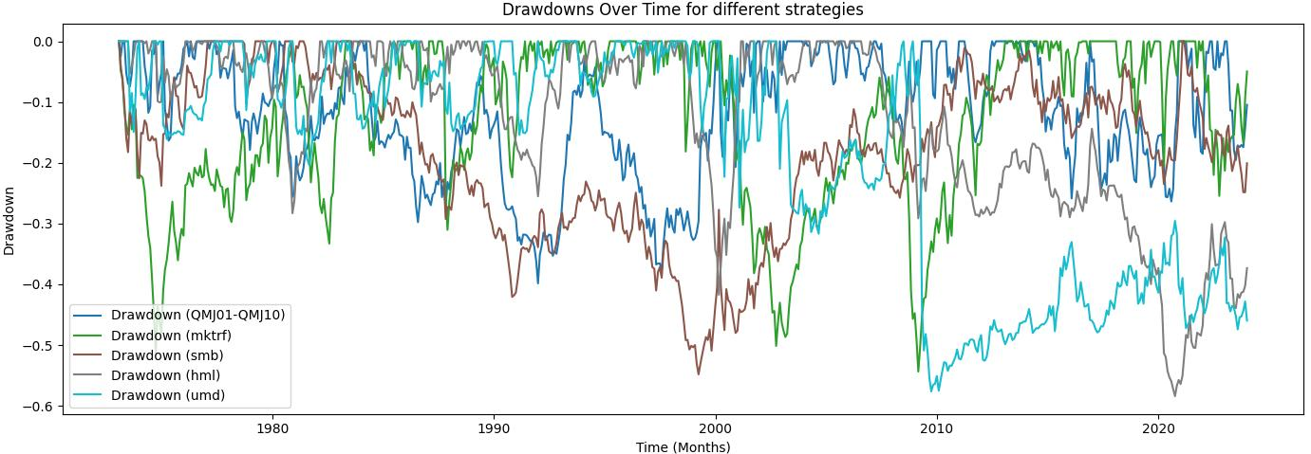
Drawdowns of different strategies

Slide 12
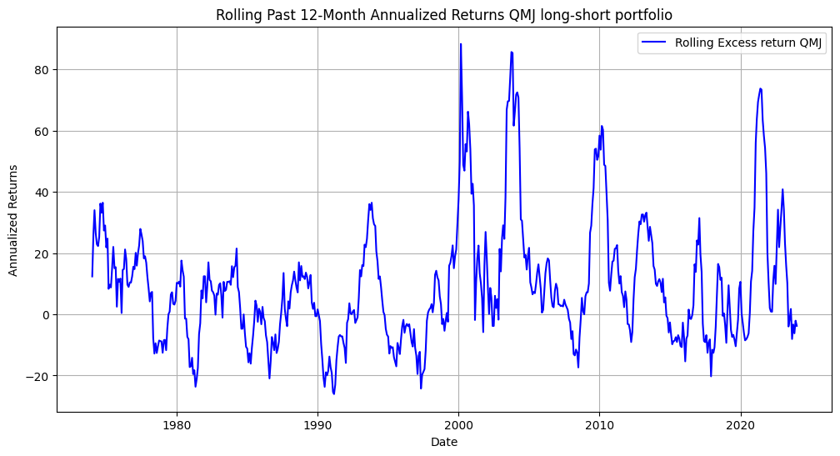
Rolling past-12 month annualized returns QMJ

Slide 13
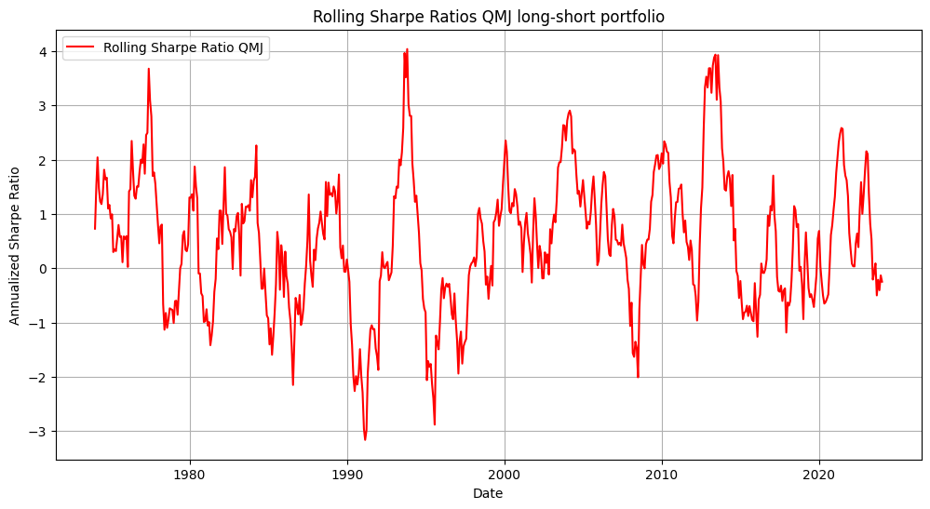
Rolling Sharpe ratio of QMJ

Slide 14
Ideas for Further Research
Portfolio Turnover and Transaction Cost
Impact on Returns: Include the effect of portfolio turnover and transaction costs on returns, alpha, and sharpe ratios.
Changing Rebalancing Frequency
Quarterly Rebalancing: Analyze the performance of the QMJ strategy with quarterly rebalancing
Portfolio Construction
Top 1% vs. Top 10%: Investigate the performance when selecting the top 1% of high-quality stocks instead of the top 10%
Transaction Cost Reduction: Evaluate whether a more selective approach (top 1%) might help reduce transaction costs

Slide 15
Thank you!

